Slide 1

WEATHER FORECASTING WT(BCSE0555)
Department of Computer Science and Engineering
CSE
(Submitted To: Mr. Rajat Kumar)
Student Name | Roll Number | Department & Section
Amarjeet Kumar Muralidhar | 2301331530022 2301331530098 | B.Tech CSE-D B.Tech CSE-D

Slide 2

Index
Introduction
Objectives
Tools & Technologies
Features
System Architecture
Screenshots (Output)
Advantages
Future Scope
Conclusion
Notes:
Aaj

Slide 3
INTRODUCTION​
Weather plays an important role in our daily life. We need to know about temperature, rain, wind, and other weather conditions to plan our day. To make this easy, I have created a simple Weather Web Application. This application shows the live weather of any city in a clear and simple way. The user can search for a city and quickly get details like temperature, humidity, wind speed, and sky condition. It is designed to be easy to use and helpful for everyone

Slide 4
Objectives
The main objective of this project is to provide people with quick and correct weather information. It is designed to be simple so that anyone can use it without difficulty. The application helps users to know the temperature, humidity, wind speed, and sky condition of any city. Another aim is to make a clean and user-friendly web design that gives the result in just a few seconds

Slide 5
Tools & Technologies
HTML & CSS → For structure and styling of web pages
JavaScript → For interactivity and API request handling
PHP → For backend processing
Weather API → For live weather data
XAMPP Server → To run PHP and test locally
VS Code → For writing and editing code

Slide 6
Features
Search weather by entering city name
Shows temperature, humidity, wind speed, and sky condition
Provides real-time data from API
Responsive design for computer and mobile
Error message for wrong or invalid city

Slide 7
System Architecture
User opens the application in a web browser
Enters the city name in the search box
The application sends a request to the weather API
The API sends back live weather data
The website displays the result to the user in a clear format

Slide 8
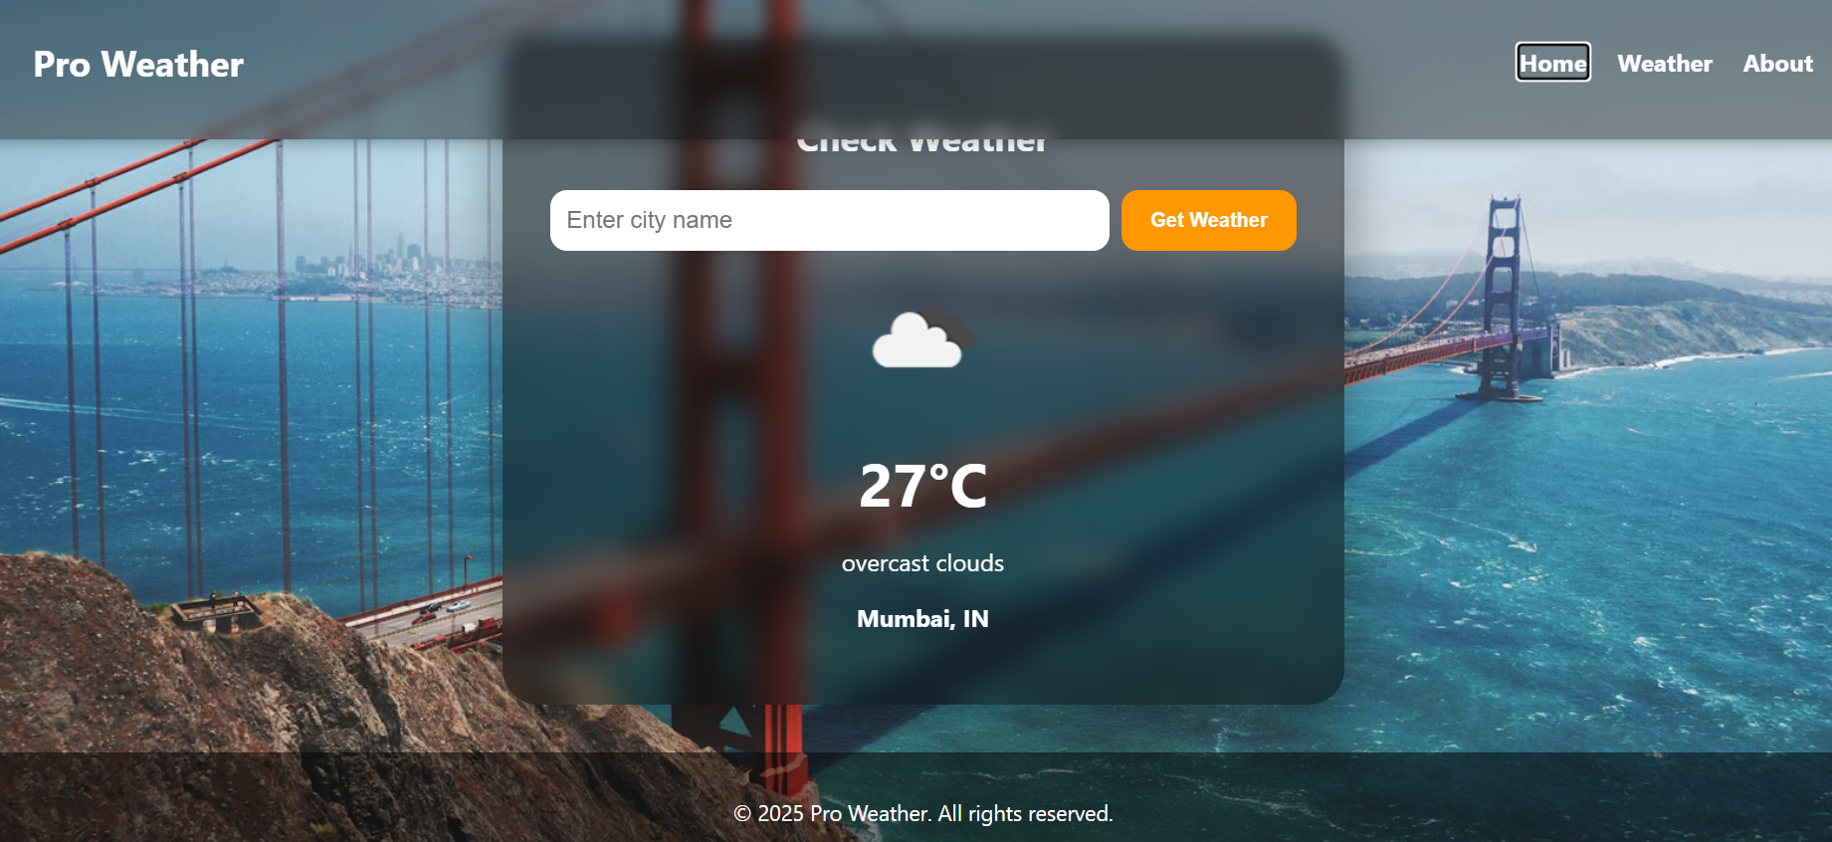
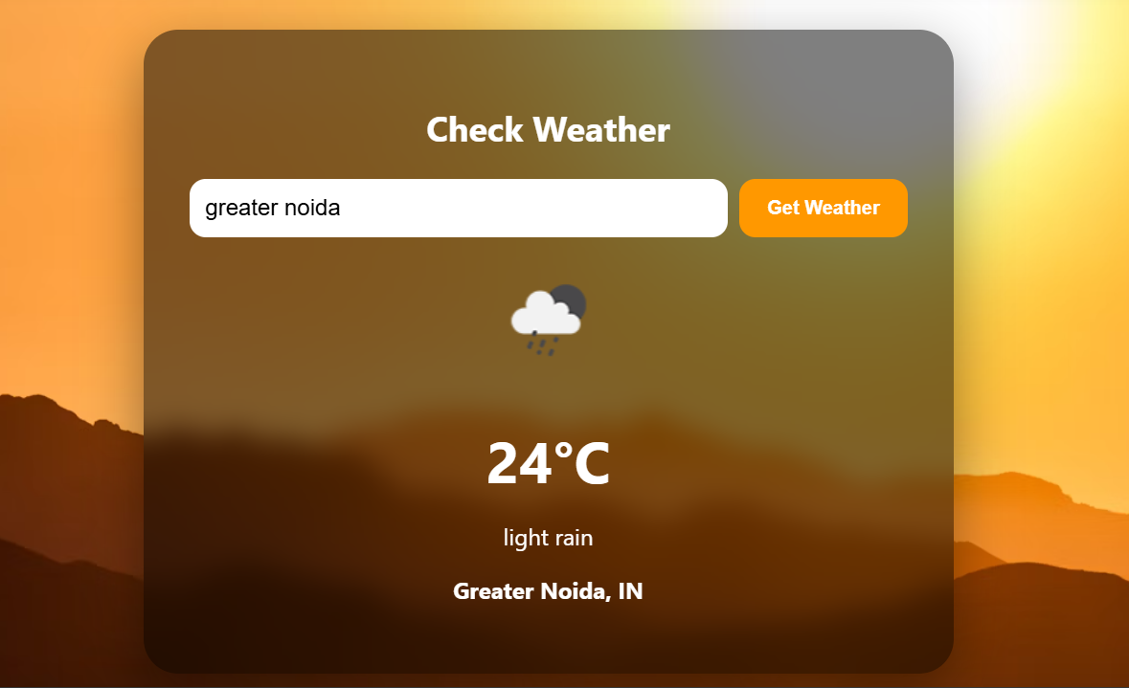
Snapshots

Slide 9
Advantages
Gives live weather updates in real time
Simple and easy to use for everyone
Works on both computer and mobile
Fast and lightweight application
Helpful for planning daily activities

Slide 10
Future Scope
Add 7-day weather forecast with charts
Auto-detect location using GPS
Add multi-language support (e.g., Hindi, English)
Store user search history in database
Show weather alerts for safety

Slide 11
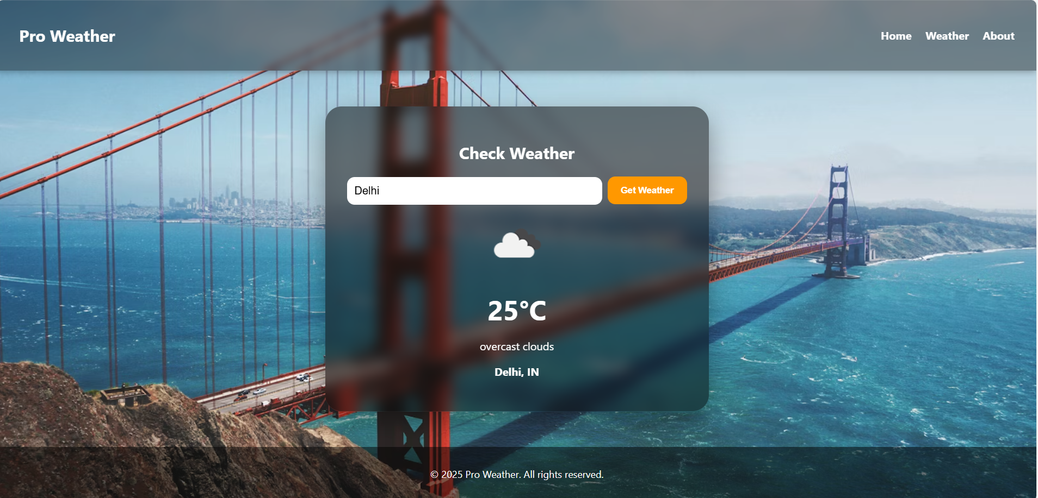
Live Demonstration of Project
Click here for Live demonstration of Weather Forecasting

Slide 12
Conclusion
The project provides live weather details in a simple way.
It is user-friendly and works on both computer and mobile.
I learned to integrate frontend, backend, and API in one project.
It can be improved with more features in the future

Slide 13
Thank You

